Slide 1
Dr. Jayaraj P B Associate Professor Department of Computer Science & Engineering, NIT Calicut
MLE & BCE
1

Slide 2
Outline
Linear Regression – a quick review
Logistic Regression
Sigmoid function
Can MSE be used for Logistic Regression?
MLE for identifying the new cost function
LogLoss (BCE) – new Cost Function
Derivative of BCE for GD
2

Slide 3
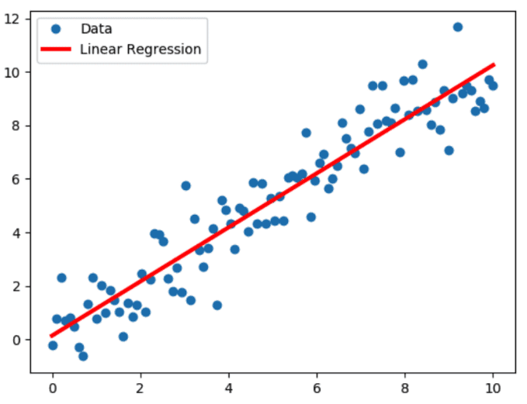

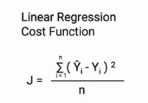
Linear Regression

Slide 4
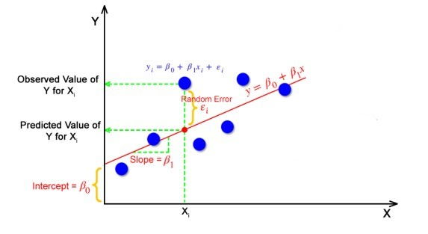

Slide 5
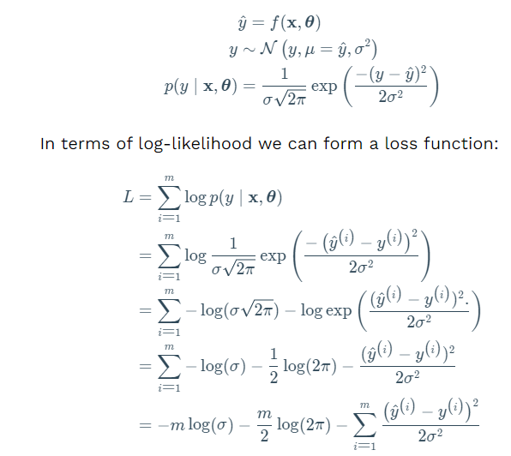
MLE & MSE

Slide 6
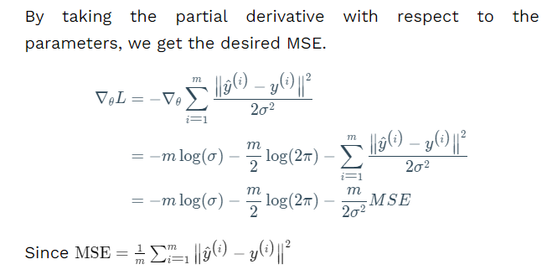

Slide 7
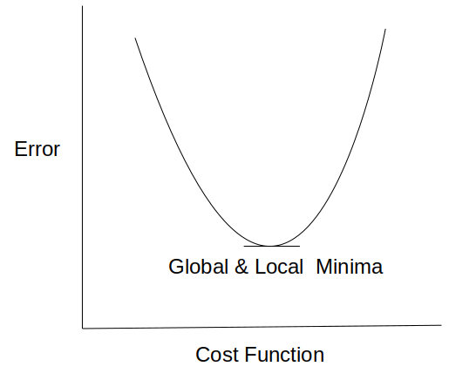
In linear regression, we use the Mean squared error which was the difference between y_predicted and y_actual and this is derived from the maximum likelihood estimator. The graph of the cost function in linear regression is like this:

Slide 8
Logistic Regression
In the Linear regression model used to make predictions for continuous variables (numeric variable).
Logistic regression is a classification model. It will help you make predictions in cases where the output is a categorical variable.
Logistic regression is easy to interpretable of all classification models.
It is very common to use various industries such as banking, healthcare, etc.

Slide 9
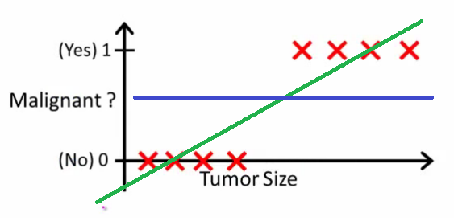
Why do we use Logistic Regression rather than Linear Regression for classification?
After reading the definition of logistic regression we now know that it is only used when our dependent variable is binary and in linear regression this dependent variable is continuous.

Slide 10
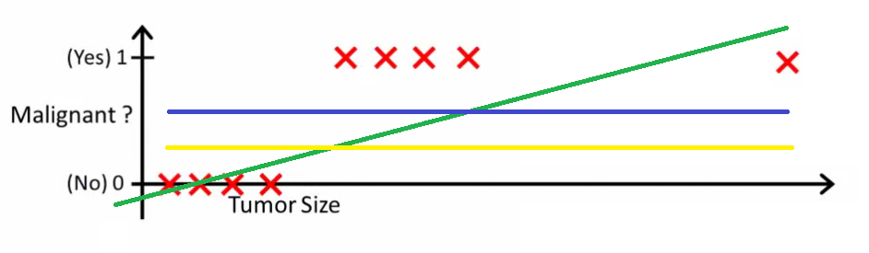
The second problem is that if we add an outlier in our dataset, the best fit line in linear regression shifts to fit that point.

Slide 11

Another problem with linear regression is that the predicted values may be out of range. We know that probability can be between 0 and 1, but if we use linear regression this probability may exceed 1 or go below 0.
Hence, we apply sigmoid function to squeeze the output between 0 to 1. Sigmoid squeezes a straight line into an S-curve.

Slide 12
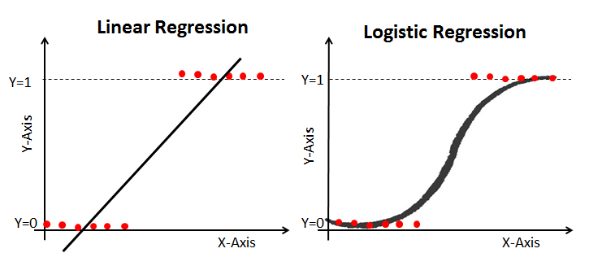
Cost Function in Logistic Regression ?
This is our logistic function, also called a sigmoid function. It squeezes a straight line into an S-curve.

Slide 13
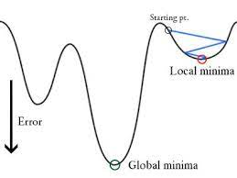
In logistic regression Yi is a non-linear function (Ŷ=1​/1+ e^{-z}). If we use this in the above MSE equation then it will give a non-convex graph with many local minima as shown above
The problem here is that this cost function will give results with local minima, which is a big problem because then we’ll miss out on our global minima and our error will increase.

Slide 14
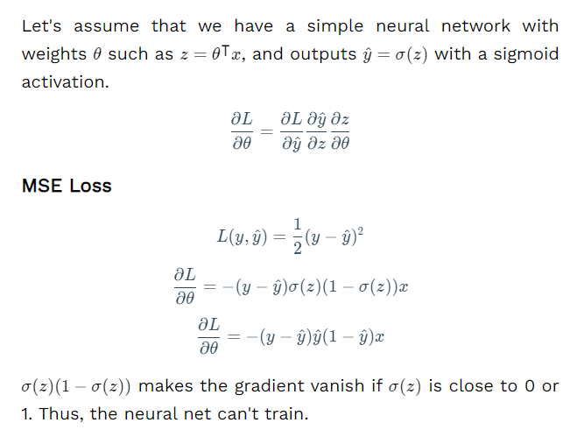
Bonus: What would happen if we use MSE on binary classification?

Slide 15

Log Loss (BCE Loss)
In order to solve this problem, we derive a different cost function for logistic regression called log loss (BCE Loss) which is also derived from the maximum likelihood estimation method.

Slide 16
MLE & BCE
Let’s start by defining our likelihood function. We now know that the labels are binary which means they can be either yes/no or pass/fail etc.
We can also say we have two outcomes success and failure. This means we can interpret each label as Bernoulli random variable.

Slide 17

Bernoulli Distribution
A random experiment whose outcomes are of two types, success S and failure F, occurring with probabilities p and q respectively is called a Bernoulli trial.
If for this experiment a random variable X is defined such that it takes value 1 when S occurs and 0 if F occurs, then
it follows a Bernoulli Distribution

Slide 18
Bernoulli Distribution is a type of discrete probability distribution where every experiment conducted asks a question that can be answered only in yes or no.
In other words, the random variable can be 1 with a probability p or it can be 0 with a probability (1 - p). Such an experiment is called a Bernoulli trial. A pass or fail exam can be modelled by a Bernoulli Distribution.

Slide 19
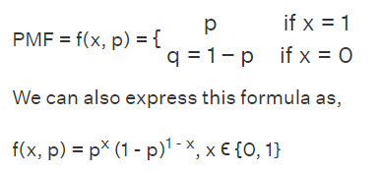
Probability Mass Function for Bernoulli Distribution

Slide 20


MLE & BCE
It follows a Bernoulli Distribution
Where P is our sigmoid function
where σ(θ*x) is the sigmoid function. Now for n observations,

Slide 21

We need a value for theta which will maximize this likelihood function.
calculate the log-likelihood
In machine learning, it is conventional to minimize a loss(error) function via gradient descent, rather than maximize an objective function via gradient ascent.

Slide 22

Cost Function
It is common practice to minimize a cost function for optimization problems; therefore, we can invert the function so that we minimize the negative log-likelihood (NLL).
max[log(x)] = min[-log(x)]
• p(y) is the probability of 1.
• 1-p(y) is the probability of 0.
Here y represents the actual class and log(σ(θ^T*x^i) ) is the probability of that class.

Slide 23
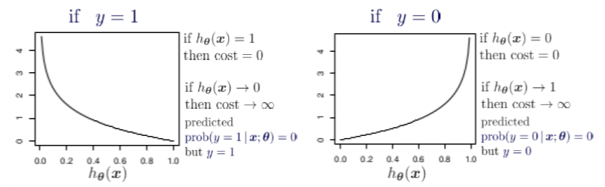
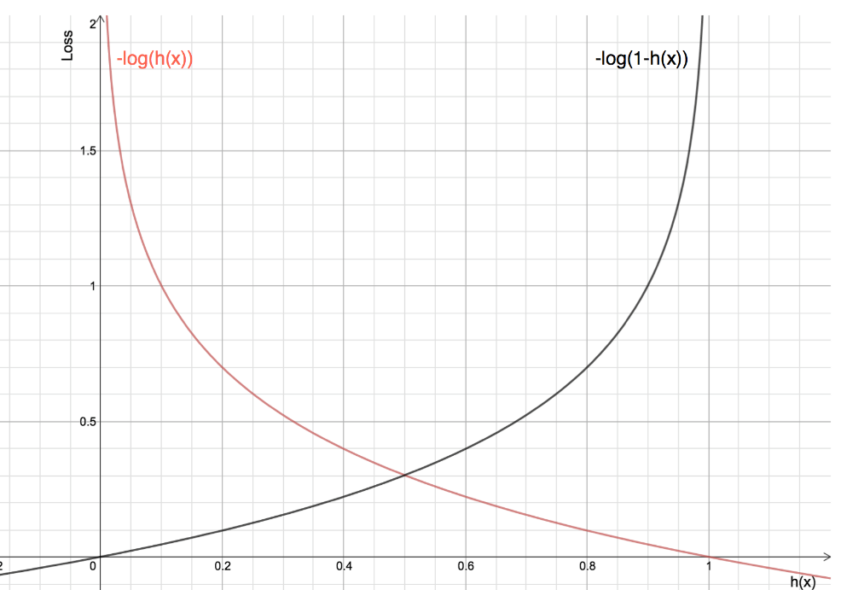

Slide 24
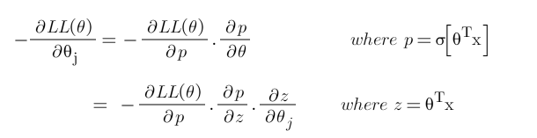
Derivate of Cost fraction
We will derive the cost function with the help of the chain rule as it allows us to calculate complex partial derivatives by breaking them down.
Step-1: Use chain rule and break the partial derivative of log-likelihood.

Slide 25
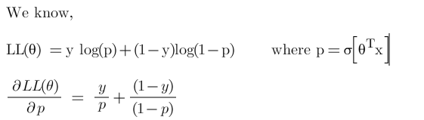
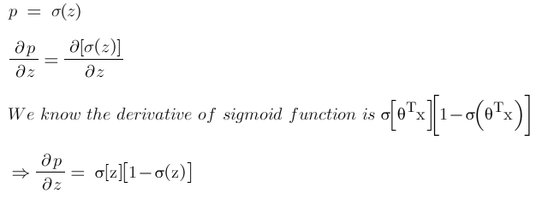
Step 3: Find derivative of log-likelihood w.r.t p
Step-3: Find derivative of ‘p’ w.r.t ‘z’

Slide 26
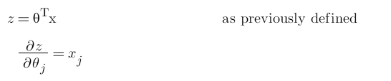
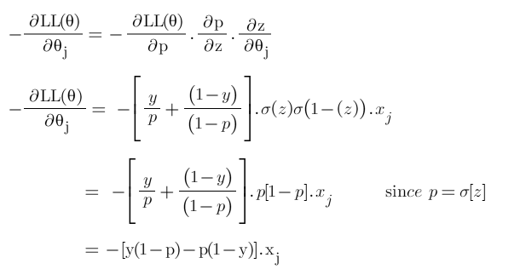
Step-4: Find derivate of z w.r.t θ
Put all the derivatives in equation 1

Slide 27
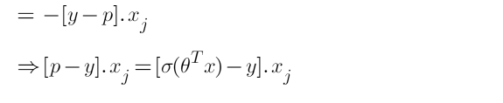

Slide 28
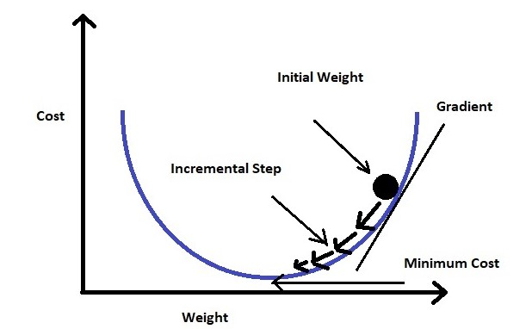
Train the model - GD
Gradient descent changes the value of our weights in such a way that it always converges to minimum point or we can also say that, it aims at finding the optimal weights which minimize the loss function of our model.
It is an iterative method that finds the minimum of a function by figuring out the slope at a random point and then moving in the opposite direction.

Slide 29


Slide 30

Derivative of the cost function is:

Slide 31
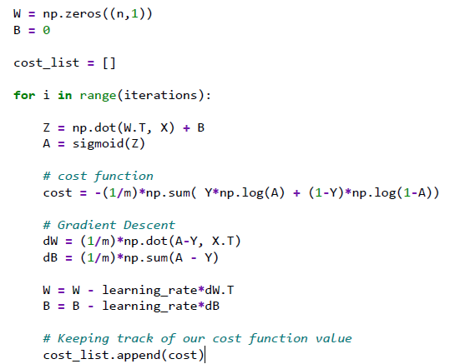
LR

Slide 33
Thank you!

